Slide 1
8 THINGS YOU MUST DO TO BE A CERTIFIED NIGERIAN

Slide 2
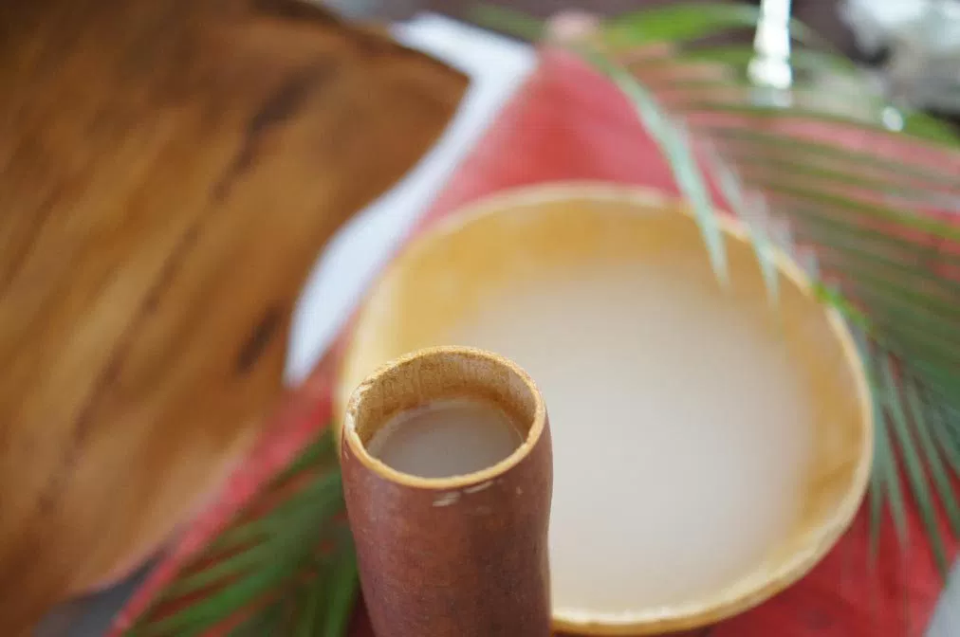
STEP 1 : TASTE PALM WINE
DEFINITION CARD TEXT ( PLACED AT THE BOTTOM OF EACH CUP)
THE AGE OLD NIGERIAN DRINK- Palm wine is an alcoholic beverage created from the sap of various species of palm trees such as the palmyra, date palms, and coconut palms.
ACTION CARD SIGNAGE TEXT
HAVE A TOAST TO NIGERIA’S GREATNESS WITH SOME PALM WINE

Slide 3
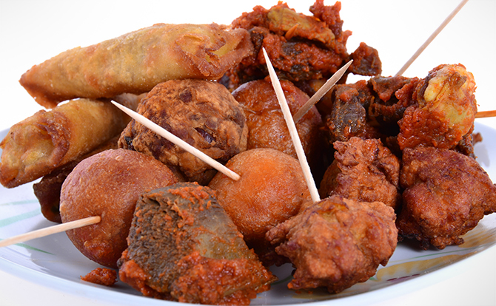
STEP 2 : EAT SMALL CHOPS
DEFINITION CARD TEXT ( PLACED AT THE BOTTOM OF EACH PLATE)
SMALL CHOPS is the Nigerian variation of finger foods which is served at special celebrations this can include spring rolls, samosa, plantain balls, peppered gizzard, puff puff e.t.c
ACTION CARD SIGNAGE TEXT
EXPERIENCE THE TASTE OF FLAVOURS WITH A PLATE OF SMALL CHOPS!

Slide 4
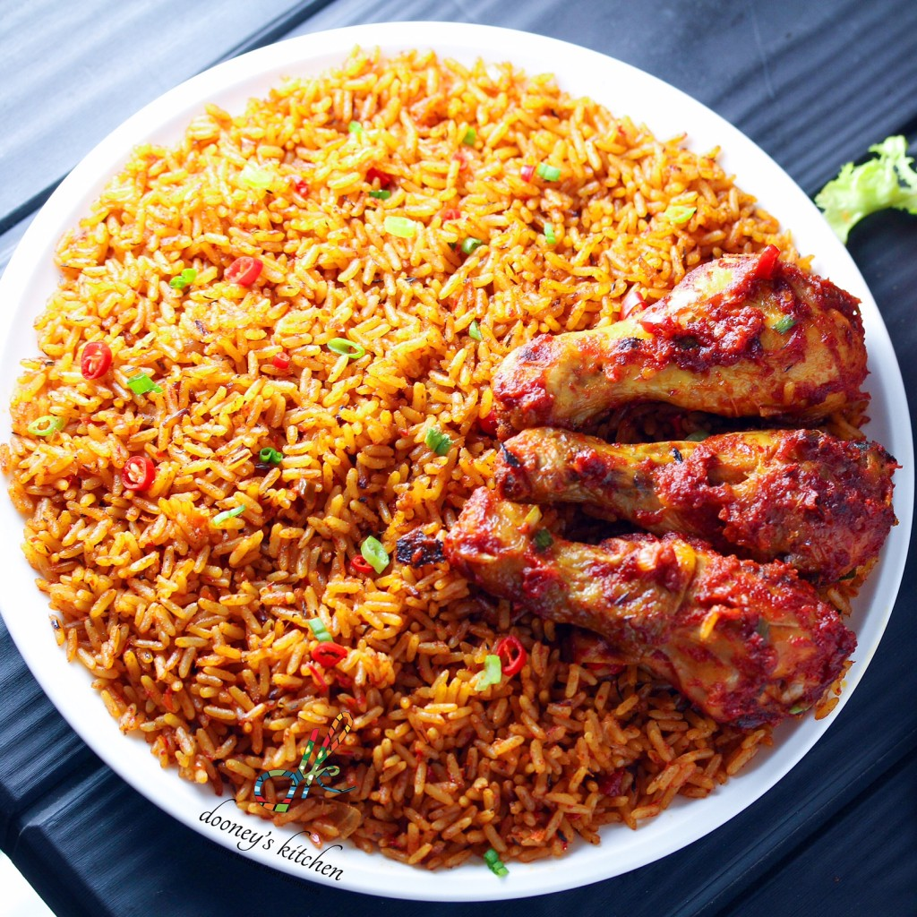
STEP 3 : EAT JOLLOF RICE
DEFINITION CARD TEXT ( PLACED AT THE BOTTOM OF EACH PLATE)
NIGERIAN JOLLOF is a one-pot rice dish which ingredients can include tomatoes and tomato paste, onions, chicken , meat and fish. It has been a cause of dispute among many African nations. NOTHING TASTES BETTER THAN NIGERIAN JOLLOF!
ACTION CARD SIGNAGE TEXT
HAVE AN AWARD WINNING PLATE OF JOLLOF RICE TODAY!

Slide 5
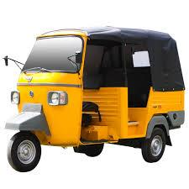
STEP 4: RIDE A KEKE
ACTION CARD SIGNAGE TEXT
LET’S TAKE A RIDE BUT FIRST, A SELFIE!
DEFINITION CARD TEXT ( PLACED AT THE BOTTOM )
The Keke Maruwa is a popular mode of transport often used during times of high traffic due to its ability to manoeuvre through tight spaces .

Slide 6
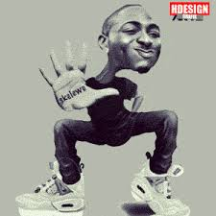
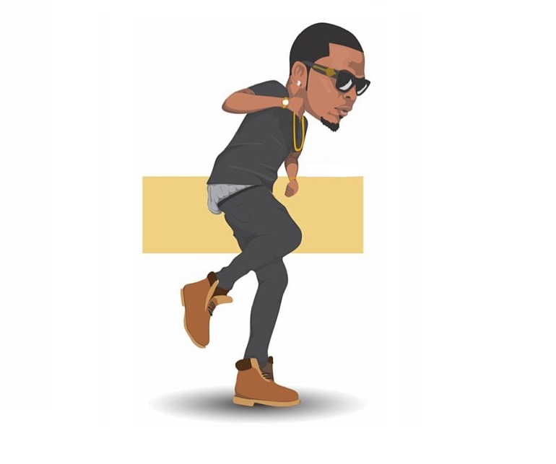
STEP 5: LEARN TO DO A NAIJA DANCE STEP
DEFINITION CARD TEXT
HOW YOU ARE DISCIPLED AT A NIGERIAN SCHOOL - SHOKI
HOW TO GET THAT TOUGH KNOT OUT OF YOUR NECK - SHAKITI BOBO
HOW TO SAY BYE TO A FRIEND AT A PARTY NAIJA STYLE- SKELEWU
ACTION CARD SIGNAGE TEXT
BUST A MOVE NAIJA STYLE.

Slide 7
STEP 6: SAY SOMETHING OR LEARN A GREETING IN A NIGERIAN LANGUAGE
DEFINITION CARD TEXT
POPULAR NIGERIAN GREETINGS
HOW FAR - HELLO
HOW YOU DEY - HOW ARE YOU?
HOW BODY- HELLO
WETIN- WHAT?
WAHALA- TROUBLE
NO WAHALA- NO PROBLEM
ABEG- PLEASE
ACTION CARD SIGNAGE TEXT
TRY NOT TO BITE YOUR TONGUE AND GREET YOUR NEIGHBOUR NAIJA STYLE.

Slide 8
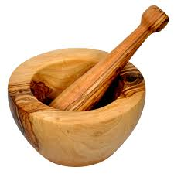
STEP 7: TAKE A PICTURE WITH A MORTAR AND PESTLE
ACTION CARD SIGNAGE TEXT
GRAB A PHOTO! IT’S NOT EVERYDAY YOU SEE TWO OF THE MOST IMPORTANT THINGS IN A NAIJA HOUSE.
DEFINITION CARD TEXT ( PLACED AT BOTTOM OF EACH ONE)
YOU CAN NOT MAKE YOUR FAVORITE POUNDED YAM WITHOUT IT - A MORTAR AND PESTLE are used in Nigerian kitchens to prepare ingredients or substances by crushing and grinding them into a fine paste or powder

Slide 9
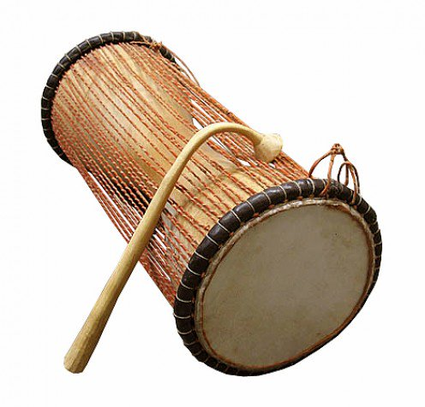
STEP 8: BEAT A TALKING DRUM
ACTION CARD SIGNAGE TEXT
CRANK UP THE VOLUME AND BEAT THAT TALKING DRUM.
DEFINITION CARD TEXT ( PLACED AT THE BOTTOM OF EACH DRUM)
IT INTRODUCES YOU INTO ANY REAL OWAMBE PARTY
THE TALKING DRUM- The talking drum is an hourglass-shaped drum from West Africa, whose pitch can be regulated to mimic the tone and prosody of human speech.

